Slide 1
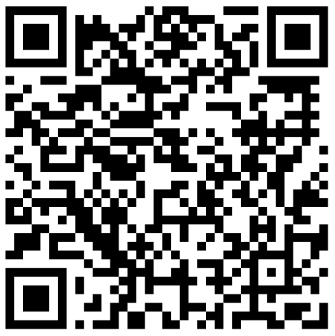
Cognitive Psychology
4: Attention 1
PSYC421
Dr. Peter Jones
peter.m.jones@plymouth.ac.uk
Office hours:
Tuesday/Thursday 1pm – 2pm, click here or scan:

Slide 4
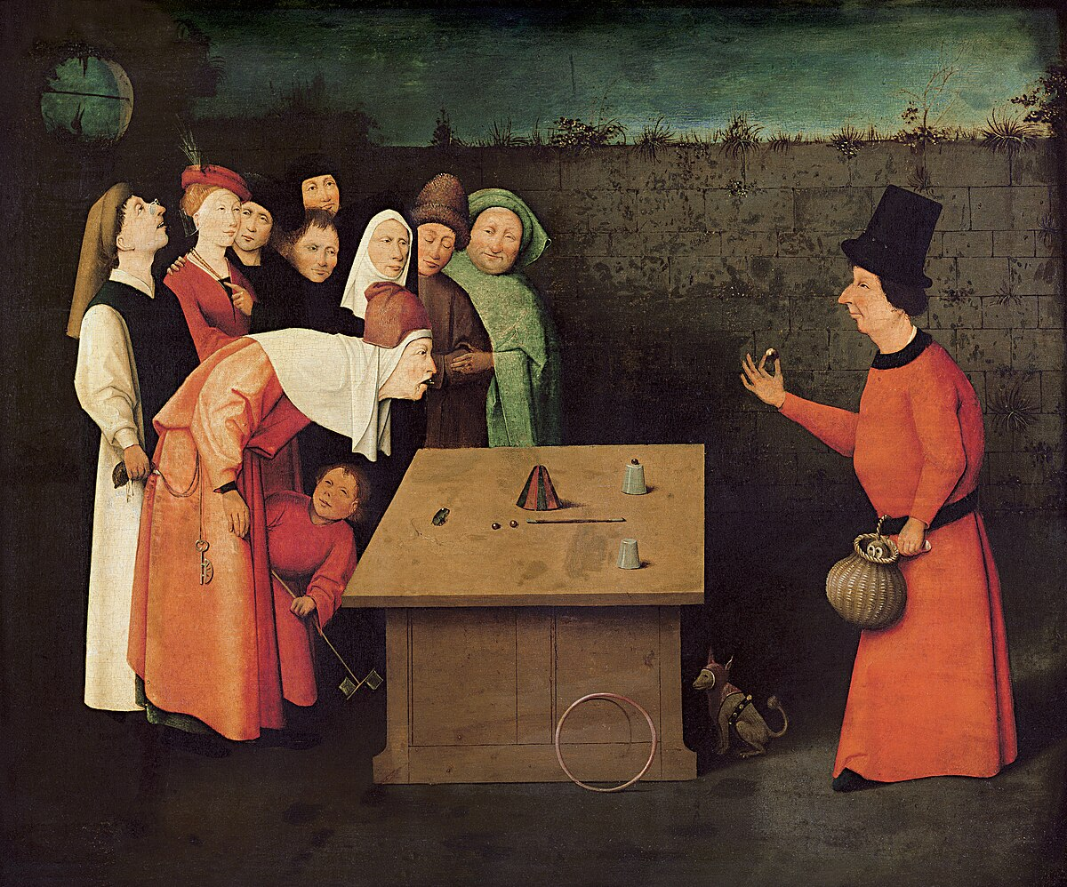
Why does this happen?
These events are unexpected
There is misdirection…
…but misdirection of what?
Notes:
The painting is Bosch’s “The Conjurer.”

Slide 5
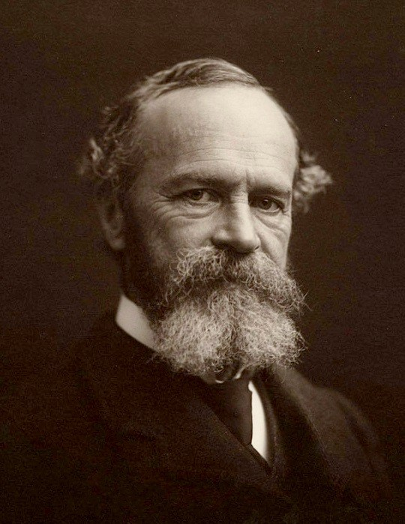
What is attention?
“Everyone knows what attention is. It is taking possession of the mind, in clear and vivid form, of one out of what seems several simultaneously possible objects or trains of thought. Focalization, concentration of consciousness are of its essence. It implies a withdrawal from some things in order to deal effectively with others” – William James
Attention is the phenomenon of processing relevant stimuli and ignoring irrelevant stimuli

Slide 6
Two ways we “pay attention”
Selective attention
The ability to focus on one thing out of many
Examples:
Reading a book on a train
Looking for your keys
Listening to a conversation
Tested by asking participants to pay attention to one stimulus
This tells us about selection processes
Divided attention
The ability to attend to multiple stimuli at once
Examples:
Talking and driving
Listening to music and studying
Singing and playing guitar
Tested by asking participants to pay attention to multiple stimuli
This tells us about processing capacity
Notes:
Both of these imply that attention is a limited resource – we can choose to put most of it in one place, or we can choose to split it between items with the consequence that each might be less well processed than if we focussed on it alone. The idea of a resource is contained in the phrase “pay attention.”

Slide 7
Two kinds of attention
Endogenous attention
Deliberate focus on stimuli
Examples:
Reading a book on a train
Looking for your keys
Listening to a conversation
Controlled by our own goals
Exogeneous attention
Capture by stimuli, often external
Examples:
Somebody calling your name
A noise outside your window
Feeling hungry
Not deliberate, often conflicts with our goals
Notes:
On the previous slide I talked about selective and divided attention in a way that suggests a deliberate choice, but our attention can be captured by stimuli that we don’t choose.

Slide 8
In these two lectures:
Today:
1. Selective attention (auditory)
2. Selective attention (visual)
Next time:
Divided attention
Distraction

Slide 9
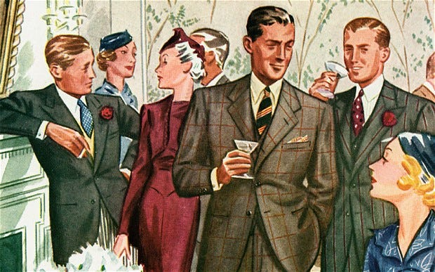
Selective attention
How do we focus on one stimulus out of many?
We must filter out irrelevant information somehow
Selective attention is the process of determining which stimuli are relevant and which are not

Slide 10
Dichotic listening task
Participants must attend to the input in one ear and ignore the other
The old man ate pasta for dinner
The brown dog chased a stick
The brown dog chased a stick
Notes:
In many (but not all) experiments, the two streams will be different voices.

Slide 11
The content in the unattended ear
Participants are aware of low-level properties, i.e. basic characteristics of the signal
- Speech vs. noise
- Changes in pitch (e.g. changes of sex)
Participants are unaware of high-level properties, i.e. the content
- Meaning
- Syntax (whether or not it makes sense)

Slide 12
When does selection happen?
Attended
Sensory buffer
FILTER
Semantic analysis
Working memory
Unattended
This is an early selection model (Broadbent, 1958)
The filter is placed after the sensory buffer but before semantic analysis
Explains sensitivity to physical characteristics but not meaning of the unattended stream

Slide 13
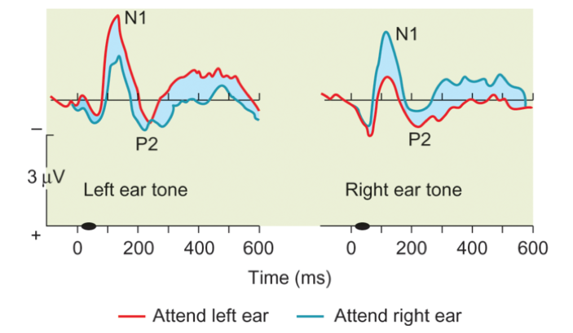
Evidence for early selection
Difference in processing of attended and unattended streams within 100 ms
– supports early selection
The task is much harder when the two streams are in the same voice
– supports selection based on sensory features
Notes:
ERP effect first reported by Hillyard et al. (1973).

Slide 14
More evidence for early selection
4
8
9
5
6
2
Participants asked to listen to both voices
Reported: 496852
Notes:
Broadbent (1958)

Slide 15
Broadbent’s filter theory
Sensory buffer
Working memory
Left channel
4 8 9 5 6 2
FILTER
Semantic analysis
496
Right channel
Sensory buffer
Working memory
Left channel
4 8 9 5 6 2
FILTER
Semantic analysis
852
Right channel
Filter based on physical characteristics, one set at a time
This prevents overloading of working memory

Slide 16
The cocktail party effect
“We just got a new kitchen”
“Peter’s such a moron”
Me

Slide 17
Problems for early selection
People are sometimes aware of what’s in the “unattended” stream
Examples:
- Your name
- Swearing
- Salient words (e.g. fire)
- If the meaning switches between streams
car
bus
book
mouse
boat
spoon
car
boat
bus

Slide 18
Late selection (Deutsch & Deutsch, 1963)
Attended
Sensory buffer
Semantic analysis
FILTER
Working memory
Unattended
The filter is placed after semantic analysis
Selection can be made on the basis of both physical characteristics and semantic content
Stimuli remembered if they require a response (e.g. they are important)

Slide 19
Problems for late selection
Secondary task:
Tap the table whenever you hear the word “green” – in either ear
Shadowed channel: 87% taps
Non-shadowed channel: 8% taps
dog
pencil
brick
foot
star
box
dog
pencil
brick
The unattended channel is not semantically processed, even when it requires a response
Notes:
Treisman and Geffen (1967)

Slide 20
The attenuation model (Treisman, 1964)
ATTENUATOR
Attended
Sensory buffer
Semantic analysis
Working memory
Unattended
Like early selection, except sensory information is moderated rather than filtered out completely
Attended information can be amplified, and unattended information attenuated
Salient information from the unattended stream can survive

Slide 21
Threshold levels
Threshold
Attended:
DARREN
WATER
DOOR
ATTENUATOR
DARREN
WATER
DOOR
PETER
SKY
DARREN
WATER
DOOR
PETER
SKY
Items over the threshold are passed to working memory
Thresholds are lower for salient words
Unattended:
PETER
SKY
Notes:
The font size here indicates the strength of signal or the size of the threshold. Attended words are boosted and above threshold, but unattended words are attenuated. Whether they are above threshold depends on what the threshold is.

Slide 22
Conclusion
Data from dichotic listening tasks suggest that unattended stimuli are often rejected early in processing
However, this is not absolute – salient stimuli still reach working memory
A question for the break:
What kind of stimuli might we find distracting?

Slide 23
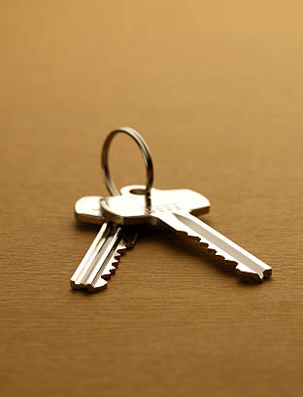
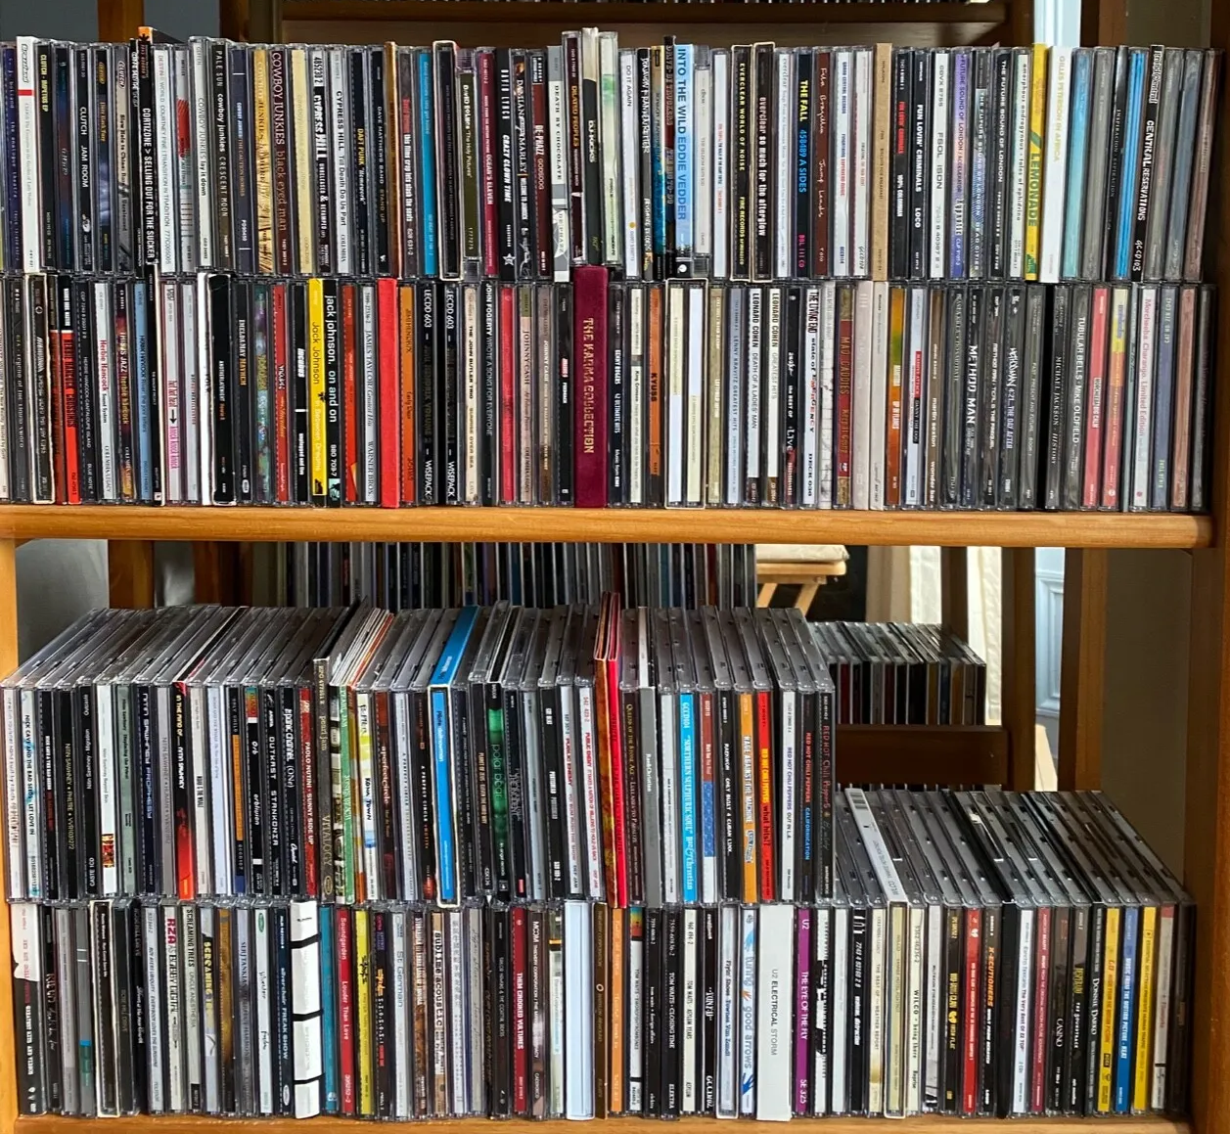
Visual search

Slide 24
How do we find Wally?

Slide 25
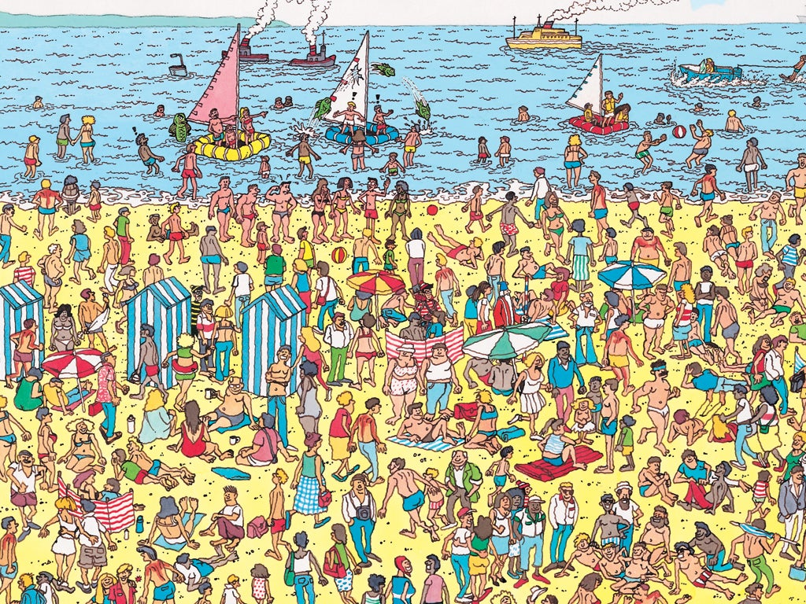

Slide 26
How do we find Wally?
Why is it difficult?

Slide 27
Find the red circle

Slide 28
Find the red circle

Slide 29
Find the red circle

Slide 30
Find the red circle

Slide 31
Find the red circle

Slide 32
Find the red circle

Slide 33
Find the red circle

Slide 34
Find the red circle

Slide 35
What this tells us
Finding red amongst blue is easy
Increasing the number of blue distractors doesn’t make it harder
What if the target and distractors differ in ways other than colour?

Slide 36
Find the letter F
E
F
E
E

Slide 37
Find the letter F
E
E
E
E

Slide 38
Find the letter F
E
E
E
F

Slide 39
Find the letter F
E
E
E
E
E
E
E
E
E
E
E
E
F
E
E
E
E
E
E
E
E
E
E
E

Slide 40
Find the letter F
E
E
E
E
E
E
E
E
E
E
E
E
E
E
E
E
E
E
E
E
E
E
E
E

Slide 41
Preattentive search
Red circles “pop out” from background of blue circles
Notes:
The red and blue features are processed in parallel, so no lengthy search required.

Slide 42
Attentive search
Finding F amongst Es requires attentive search – serial search for a conjunction of features

Slide 43
Feature integration theory
If a single feature (e.g. red) allows detection then it is pre-attentive
If detection requires a conjunction of features then it is attentive
Attention is required to bind features together
Notes:
Treisman and Gelade (1980)

Slide 44
Find the horizontal line

Slide 45
Find the red circle

Slide 46
Find the red circle

Slide 47
Presence vs. absence of target
Notes:
Treisman, Sykes, and Gelade (1977)

Slide 48
Feature integration theory - summary
Fast, parallel processing of single features
Slower, serial processing of feature conjunctions – attention required to bind features into objects
Searching for conjunction stimuli requires search of every object until the target is located
Notes:
Ask students if this seems like a good theory. Are there any problems?
It doesn’t say anything about the properties of the distractors. As we’re about to see, there are things we can do to the distractors that mean we won’t have to search through all of them.

Slide 49
Find the red circle (15 distractors)

Slide 50
Find the red circle (29 distractors)

Slide 51
Guided search – Wolfe (1998)
Each target feature (red, circle) is activated for search
Search restricted to objects with high activation
Non-activated objects are excluded from this “activation map” and easily ignored

Slide 52
Similarity of distractors
Target: “L”
T
T
T
T
T
T
T
T
T
T
T
T
L
T
T
T
T
L
T
T
T
T
T
T
T
T
T
T
T
T
T
T
T
T
The array on the left can be solved more quickly
Distractors are similar so they can be “grouped” and rejected together
Notes:
Duncan and Humphreys (1989)

Slide 53
Visual search summary
Targets (two-stage process):
- Fast processing of features
- Slower search for conjunctions
Distractors:
- Easily ignored if no target features are present
- Targets with the same conjunctions can be rejected together

Slide 54
Auditory and visual attention
Selective attention guides our analysis of stimulus features, not the perception of the features themselves
ATTENUATOR
Attended
Sensory buffer
Semantic analysis
Working memory
Unattended
Next week: What happens when our attention is divided?

Slide 55
Perhaps insert a section about selective attention costs, e.g. the Posner cueing paradigm. Selective attention matters because it is a limited resource etc.

